Slide 1

MY
SQL
BY-
ADITYA SHARMA
ROLL NO: 06; CLASS XII- A

Slide 2

BY-
ADITYA SHARMA
ROLL NO: 06; CLASS XII- A
AN
INTRODUCTION

Slide 3

BY-
AN
INTRODUCTION
ROLL NO: 06; CLASS XII- A
ADITYA SHARMA

Slide 4
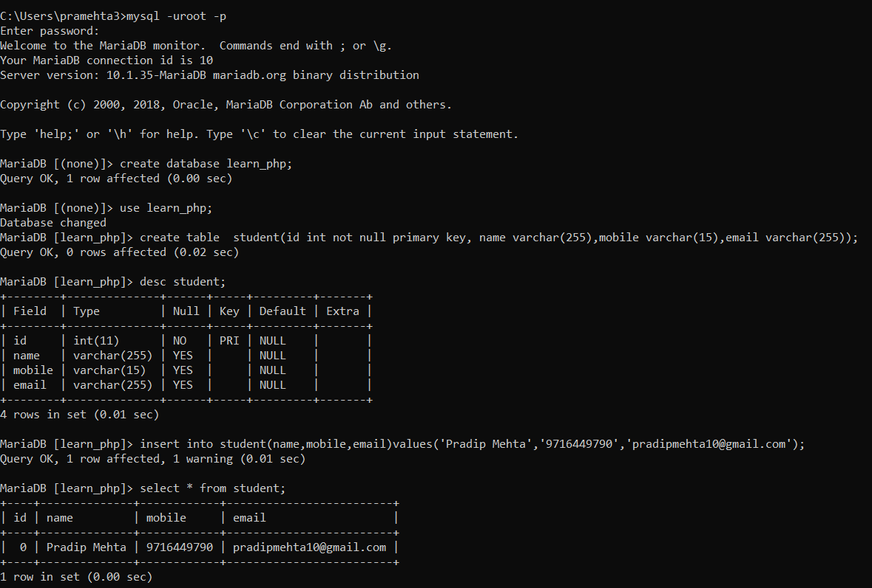
MY SQL

Slide 5
BENEFITS:-
MY SQL
A database is a separate application that stores a collection of data. Each database has one or more distinct APIs for creating, accessing, managing, searching and replicating the data it holds.
MySQL is a fast, easy-to-use RDBMS being used for many small and big businesses. MySQL is developed, marketed and supported by MySQL AB, which is a Swedish company.
MySQL is released under an open-source license. So you have nothing to pay to use it.
MySQL is a very powerful program in its own right. It handles a large subset of the functionality of the most expensive and powerful database packages.
MySQL uses a standard form of the well-known SQL data language.
MySQL works on many operating systems and with many languages including PHP, PERL, C, C++, JAVA, etc.
MySQL works very quickly and works well even with large data sets.
MySQL is very friendly to PHP, the most appreciated language for web development.

Slide 6
MY SQL
BENEFITS:-
MySQL is released under an open-source license. So you have nothing to pay to use it.
MySQL is a very powerful program in its own right. It handles a large subset of the functionality of the most expensive and powerful database packages.
MySQL uses a standard form of the well-known SQL data language.
MySQL works on many operating systems and with many languages including PHP, PERL, C, C++, JAVA, etc.
MySQL works very quickly and works well even with large data sets.
MySQL is very friendly to PHP, the most appreciated language for web development.
A database is a separate application that stores a collection of data. Each database has one or more distinct APIs for creating, accessing, managing, searching and replicating the data it holds.
MySQL is a fast, easy-to-use RDBMS being used for many small and big businesses. MySQL is developed, marketed and supported by MySQL AB, which is a Swedish company.

Slide 7
Some common codes
SHOW TABLES;
TO VIEW EXISTING TABLES
CREATE TABLE <TABLE_NAME>
-->(<COLUMN_NAME> <DATA_TYPE>);
TO CREATE A NEW TABLE
CREATE DATABASE <NAME>;
TO CREATE A NEW DATABASE

Slide 8
Some common codes
TO CREATE A NEW DATABASE
CREATE DATABASE <NAME>;
TO CREATE A NEW TABLE
CREATE TABLE <TABLE_NAME>
-->(<COLUMN_NAME> <DATA_TYPE>);
TO VIEW EXISTING TABLES
SHOW TABLES;

Slide 9

THANK YOU

